Slide 1
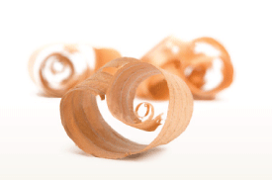
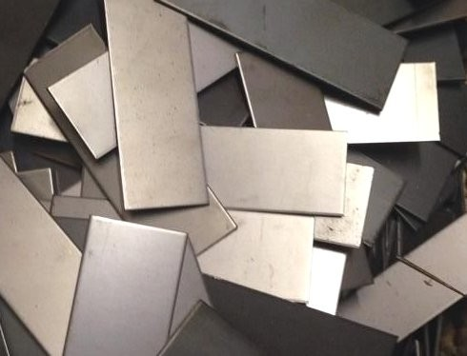
Daily Review
CFU 1
Do the substances have different densities? Will one float or sink in water?
Which technique?
Mr Ritchie wants to put some wood shavings in his garden, but they have been mixed up with some scrap metal. What should he do? (The metal is not magnetic.)
CFU 2
Should we call what we will do decanting or flotation? Why?
Identifying a separation technique
1. If one substance is magnetic: magnetic separation 2. Do the substances have different densities? If one will sink in water: decanting If one will float in water: flotation
The wood shavings will float, but the scrap metal will not, so he could use flotation.
Vocabulary
mag·net·ic (adjective) attracted to magnets de·cant·ing (verb) pouring out a liquid, leaving the sediment behind flo·ta·tion (noun) scooping up the substances floating on the top of a mixture

Slide 2
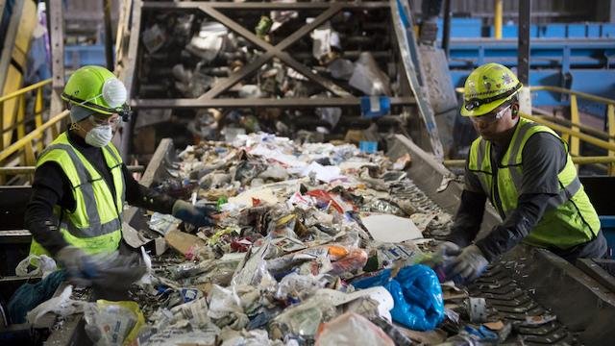
Daily Review
CFU 1
Is one substance magnetic?
Which technique?
A recycling plant is looking for a way to separate tin cans from paper and plastic. How should they do this?
CFU 2
Do the substances have different densities? Will one float or sink in water?
The tin cans are magnetic and the paper / plastic is not, so they could use magnetic separation.
Identifying a separation technique
1. If one substance is magnetic: magnetic separation 2. Do the substances have different densities? If one will sink in water: decanting If one will float in water: flotation
Vocabulary
mag·net·ic (adjective) attracted to magnets de·cant·ing (verb) pouring out a liquid, leaving the sediment behind flo·ta·tion (noun) scooping up the substances floating on the top of a mixture

Slide 3
Separating Mixtures: Filtration and Centrifuging Year 7 Science

Slide 4
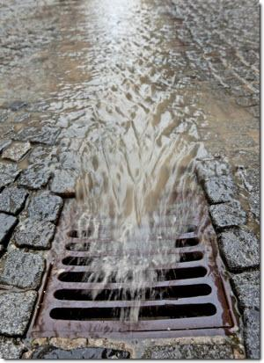
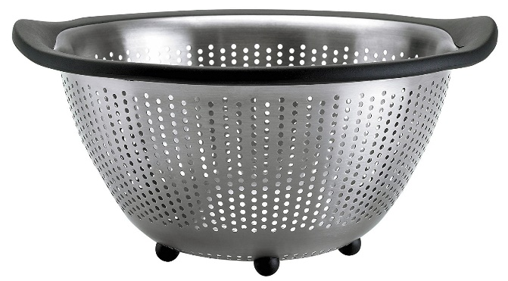
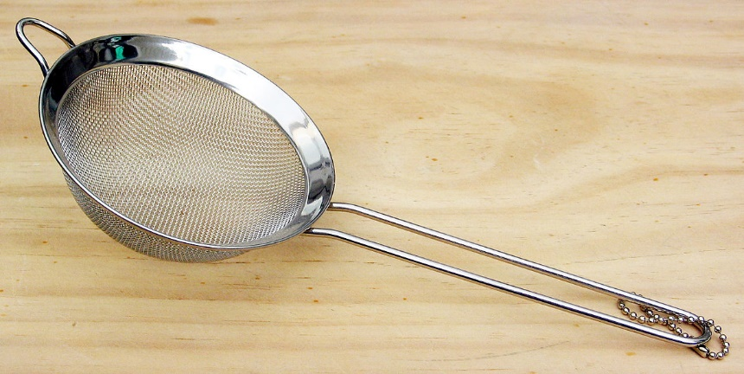
Learning Objectives
CFU
Write any unfamiliar words from the objectives on your whiteboard.
Explain how and when filtration can be used to separate mixtures.
Define centrifuging.
Explain how and when centrifuging can be used to separate mixtures.
Activate Prior Knowledge
Think, Pair, Share: name each of these objects and describe what it is used for.

Slide 5
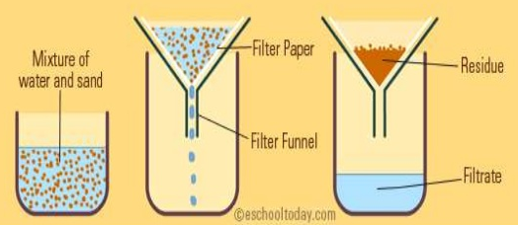
Concept Development
CFU 1
What does a filter do?
Filtration
A filter has holes in it so that it lets small things and liquids through, but traps bigger particles.
The substance/s that pass through the filter are called the filtrate, and those that do not get through are called the residue.
CFU 2
In your own words, what is a filtrate?
CFU 3
In your own words, what is a residue?
Vocabulary
fil·tra·tion (noun) using a filter to separate the parts of a mixture; also called filtering fil·trate (noun) the substance/s that pass through a filter re·si·due (noun) the substance/s that don’t pass through a filter

Slide 6
Skill Development / Guided Practice
Filtration
The substance/s that pass through a filter are called the filtrate, and those that do not get through are called the residue.
Write the words that should go in the blanks on your whiteboards.
CFU 1
What is the difference between filtrate and residue?
Vocabulary
fil·tra·tion (noun) using a filter to separate the parts of a mixture; also called filtering fil·trate (noun) the substance/s that pass through a filter re·si·due (noun) the substance/s that don’t pass through a filter
fly screen filtrate: air residue: bugs, leaves | colander filtrate: __________ residue: __________
 | vacuum cleaner filtrate: __________ residue: __________

Slide 7
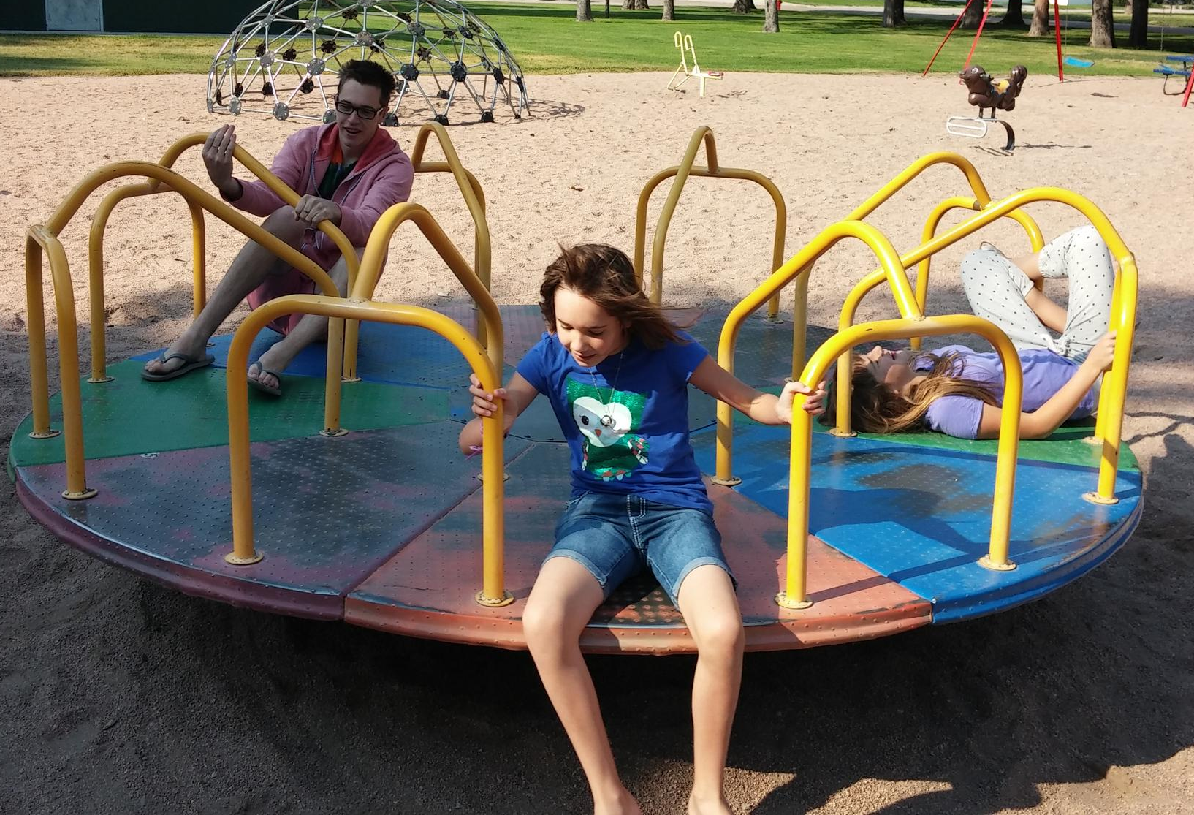
Activate Prior Knowledge
Have you ever used one of these at a playground?
What sort of forces do you experience while you’re spinning?

Slide 8
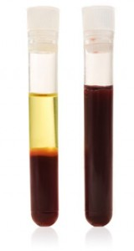
Concept Development
CFU 1
Which parts of a mixture are pulled out the most when it is spun around?
Centrifuging
When a mixture is spun around, the heavier parts of it are pulled outwards more than the lighter parts are.
Spinning a mixture very quickly to separate light and heavy particles is called centrifuging. This is done using a machine called a centrifuge.
CFU 2
Which part of your blood is heavier: the blood cells or the plasma? How do you know?
Vocabulary
cen·tri·fu·ging (noun) spinning a mixture around to separate the heavy parts from the light parts cen·tri·fuge (noun) a machine which spins mixtures around
plasma
whole
blood
blood cells

Slide 9
Skill Development / Guided Practice
Centrifuging
When a mixture is spun around, the heavier parts of it are pulled outwards more than the lighter parts are.
Spinning a mixture very quickly to separate light and heavy particles is called centrifuging. This is done using a machine called a centrifuge.
To watch a strawberry being centrifuged, click the link below:
https://www.youtube.com/watch?v=FIG8WrgH3d8

Slide 10
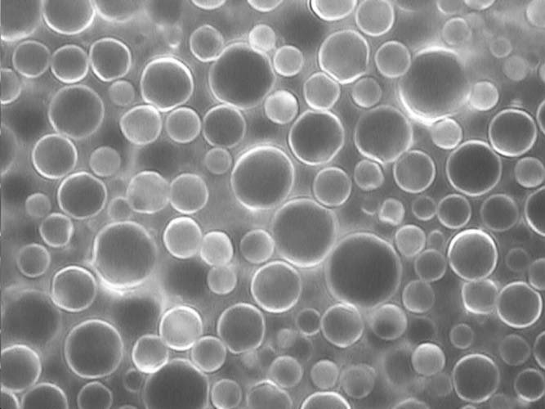
Skill Development/Guided Practice
CFU 1
Would only one substance get caught in a filter?
Which technique?
A dairy farmer needs to separate some of the fat from the rest of his milk to make cream. What should he do?
CFU 2
Is one substance lighter than the other?
Identifying a separation technique
1. If one substance would be caught in a filter and the other wouldn’t: filtration 2. If one substance is lighter than the other: centrifuging
Fat is lighter than the rest of the milk, so he should use centrifuging.
Vocabulary
fil·tra·tion (noun) using a filter to separate the parts of a mixture; also called filtering cen·tri·fu·ging (noun) spinning a mixture around to separate the heavy parts from the light parts
Raw milk magnified 4200 times

Slide 11
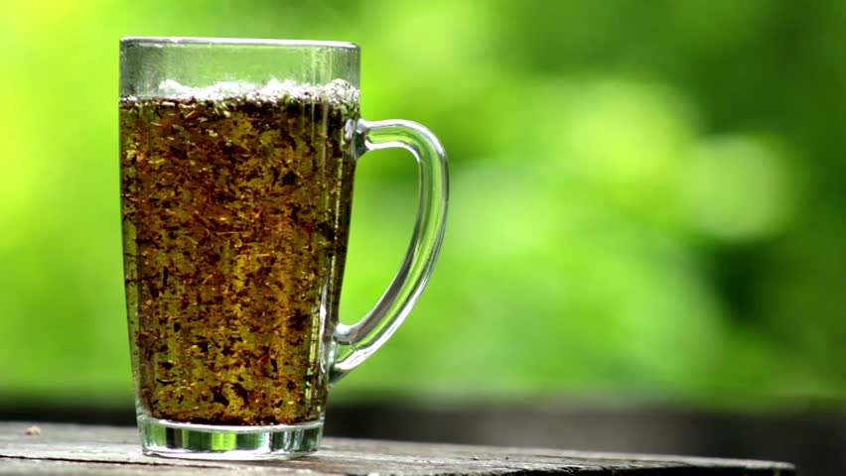
Skill Development/Guided Practice
CFU 1
Would only one substance get caught in a filter?
Which technique?
Vicky has made some tea, but needs to get the leaves out. The leaves are too small to decant the tea easily. What should she do?
CFU 2
Is one substance lighter than the other?
The tea leaves would be caught in a filter, so she should use filtration.
Identifying a separation technique
1. If one substance would be caught in a filter and the other wouldn’t: filtration 2. If one substance is lighter than the other: centrifuging
Vocabulary
fil·tra·tion (noun) using a filter to separate the parts of a mixture; also called filtering cen·tri·fu·ging (noun) spinning a mixture around to separate the heavy parts from the light parts

Slide 12
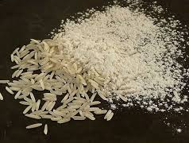
Skill Development/Guided Practice
CFU 1
Would only one substance get caught in a filter?
Which technique?
Sally was baking and accidentally poured rice into the flour for her cake. How could she separate the rice and flour?
CFU 2
Is one substance lighter than the other?
Identifying a separation technique
1. If one substance would be caught in a filter and the other wouldn’t: filtration 2. If one substance is lighter than the other: centrifuging
Vocabulary
fil·tra·tion (noun) using a filter to separate the parts of a mixture; also called filtering cen·tri·fu·ging (noun) spinning a mixture around to separate the heavy parts from the light parts

Slide 13
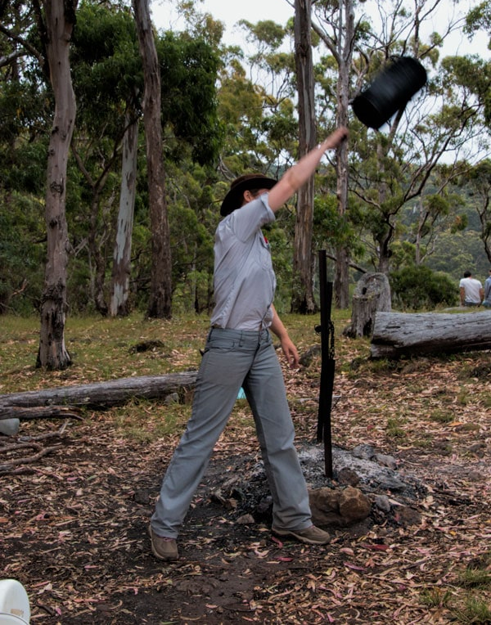
Skill Development/Guided Practice
CFU 1
Would only one substance get caught in a filter?
Which technique?
When making tea in a billy can, it is swung around in a circle to separate the tea leaves from the tea. What type of separation is this?
CFU 2
Is one substance lighter than the other?
Identifying a separation technique
1. If one substance would be caught in a filter and the other wouldn’t: filtration 2. If one substance is lighter than the other: centrifuging
Vocabulary
fil·tra·tion (noun) using a filter to separate the parts of a mixture; also called filtering cen·tri·fu·ging (noun) spinning a mixture around to separate the heavy parts from the light parts

Slide 14
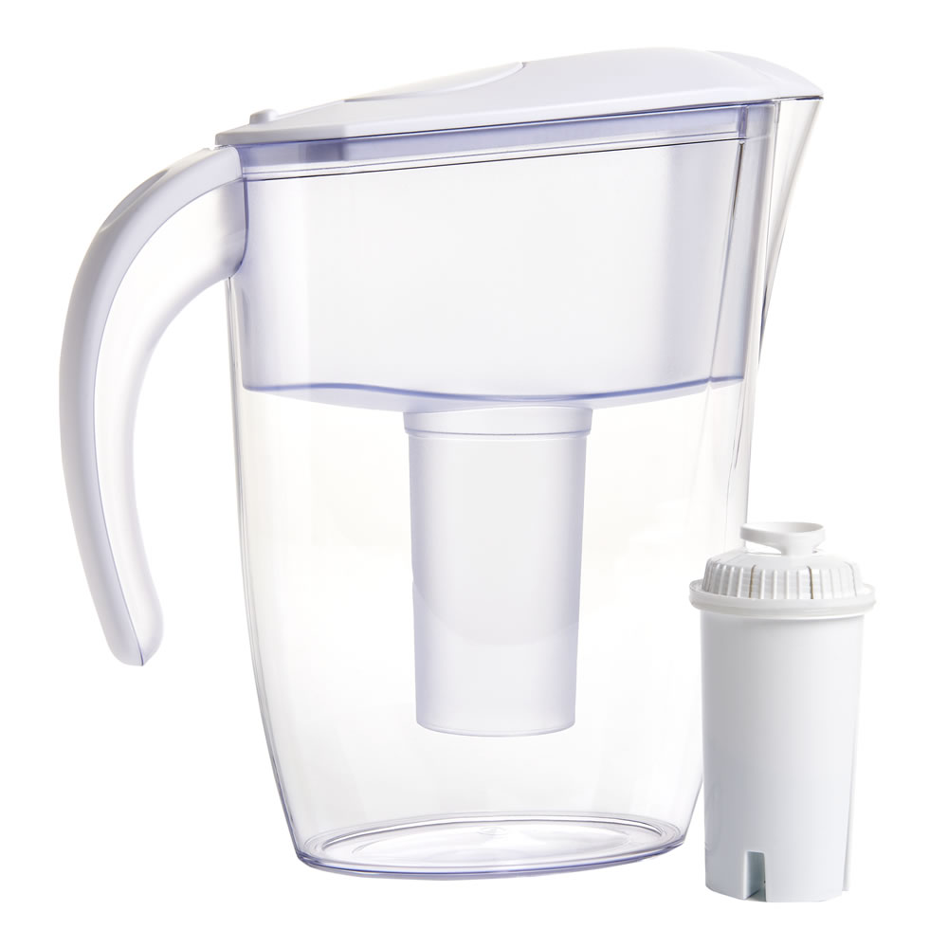
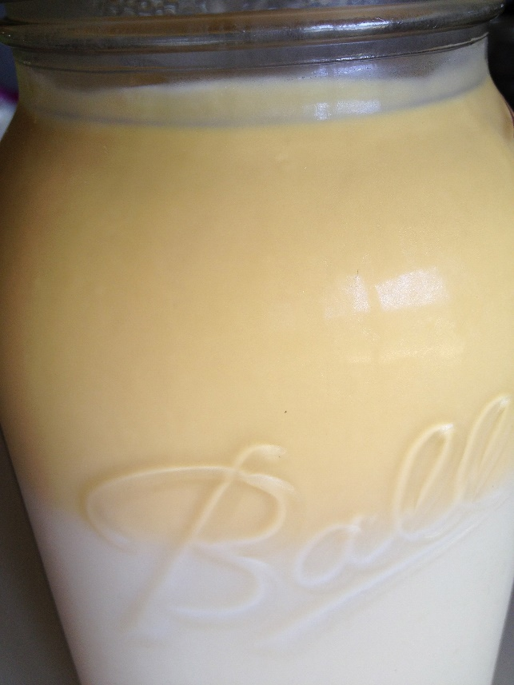
Relevance
Filtration is used in chemistry, medicine, cooking, water treatment, and many other fields.
Centrifuging is used in medicine, dairies (to separate milk and cream), and mining.

Slide 15
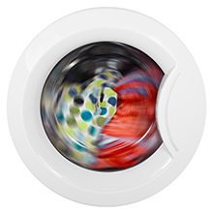
Skill Closure
Give one example of a filter that you might find at home. What two things does it separate? (do not clean your board after)
Identify the filtrate and residue in each of the examples you mentioned.
A washing machine is an example of a centrifuge. What does it separate?
Skill Closure
Skill Closure
Vocabulary
fil·trate (noun) the substance/s that pass through a filter re·si·due (noun) the substance/s that don’t pass through a filter

Slide 16
Independent Practice
Complete Questions 1-4 on the worksheet.
You will need to look at page 36 in your textbooks to help you.

